Slide 1
Author Identification Using Chaos Game Representation and Deep Learning
Aleksandr Pitkin 333879013
Ilya Vorotyntsev 324755735

Slide 2
Abstract
The study presents a new method to identify authors by converting their writing style into images.
This method uses chaos game representation to create the images.
These images are analyzed by a deep learning (DL) method to learn each author's unique style.
DL can identify the author of new documents by comparing them to the learned styles.
Experiments on three data sets show the method is effective, even with limited data.
The study explores if using more diverse images improves accuracy.

Slide 3
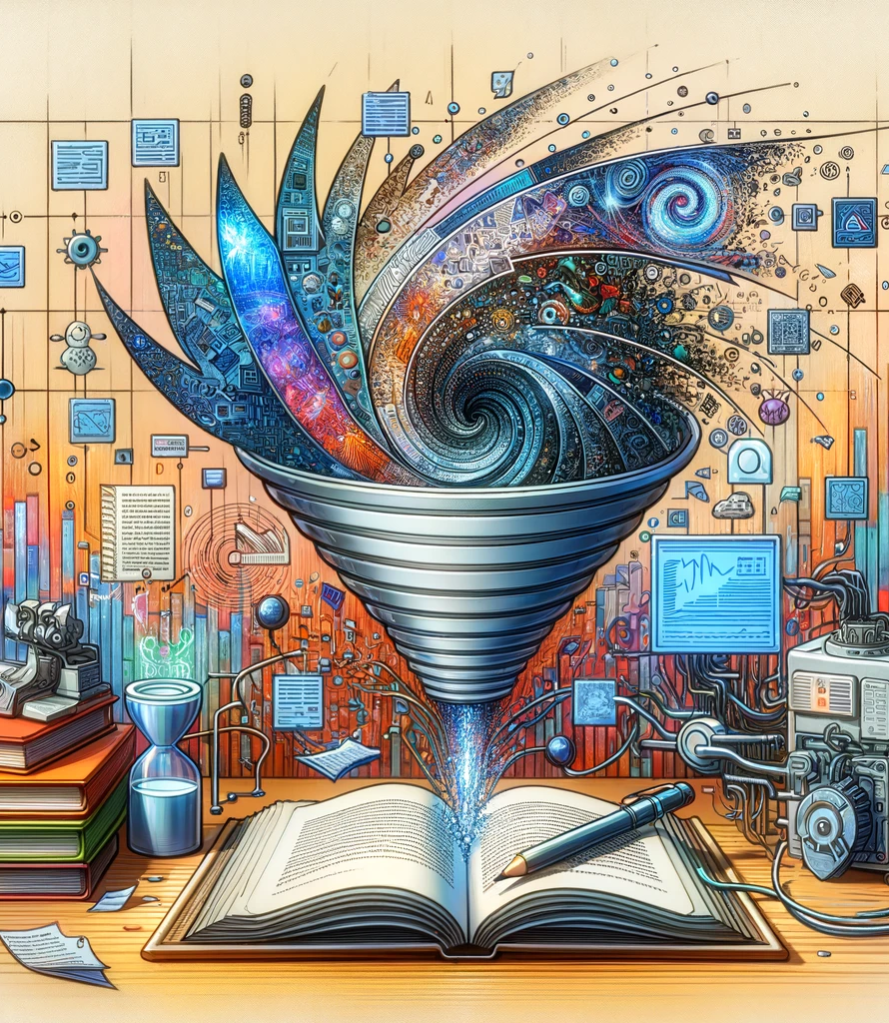
Introduction
The study presents a new method to identify authors by converting their writing style into images.
This method uses chaos game representation to create the images.
These images are analyzed by a deep learning (DL) method to learn each author's unique style.
DL can identify the author of new documents by comparing them to the learned styles.
The study uses GANs, to synthetically increase the dataset by creating new CGR images.

Slide 4
Introduction
The study focuses on whether the CGR-DL combination works well for authorship attribution and explores three main questions:
- Can DL effectively use CGR images to tell authors apart?
- Does DL need many CGR images to be accurate?
- Can making more images artificially help improve accuracy when there aren't many samples?

Slide 5
Materials
Dataset | Number of Authors | Number of Articles
CCAT10 | 10 | 100
IMDb62 | 62 | 1000
The Cuckoo's Calling | 7 | 1
The goal is to evaluate the deep learning model's performance in identifying authors under different conditions and with various types of data.

Slide 6
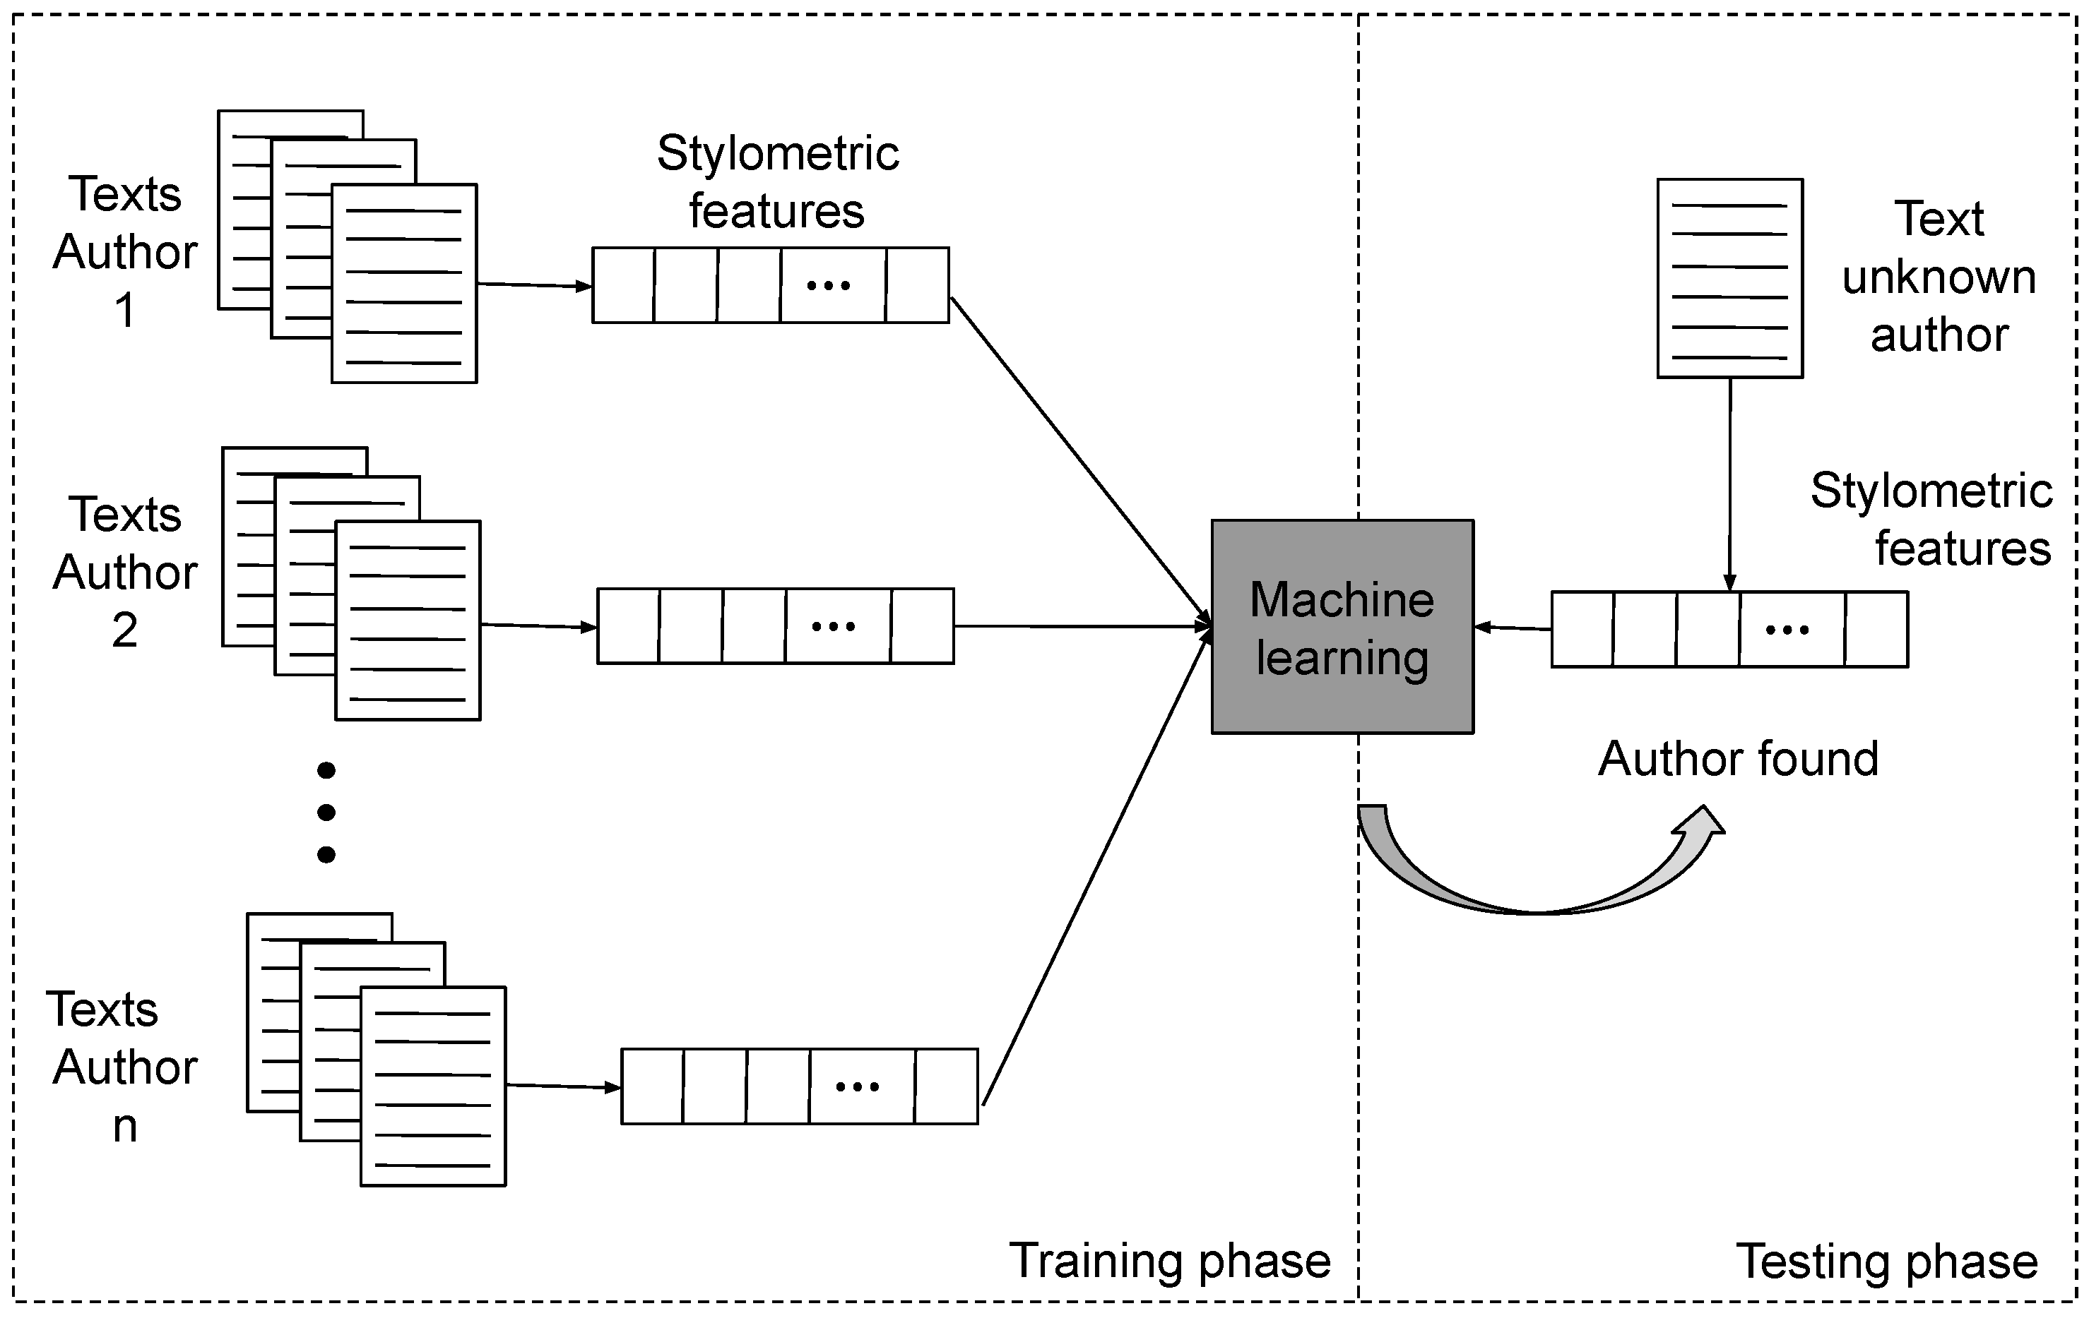
Proposed CGR-DL Approach
State of the Art
Traditional authorship attribution methods focus on ways a writer uses words, sentences, and grammar, almost like a writing fingerprint.
Machine learning classifiers, such as support vector machines, are used to match these features with specific authors.

Slide 7
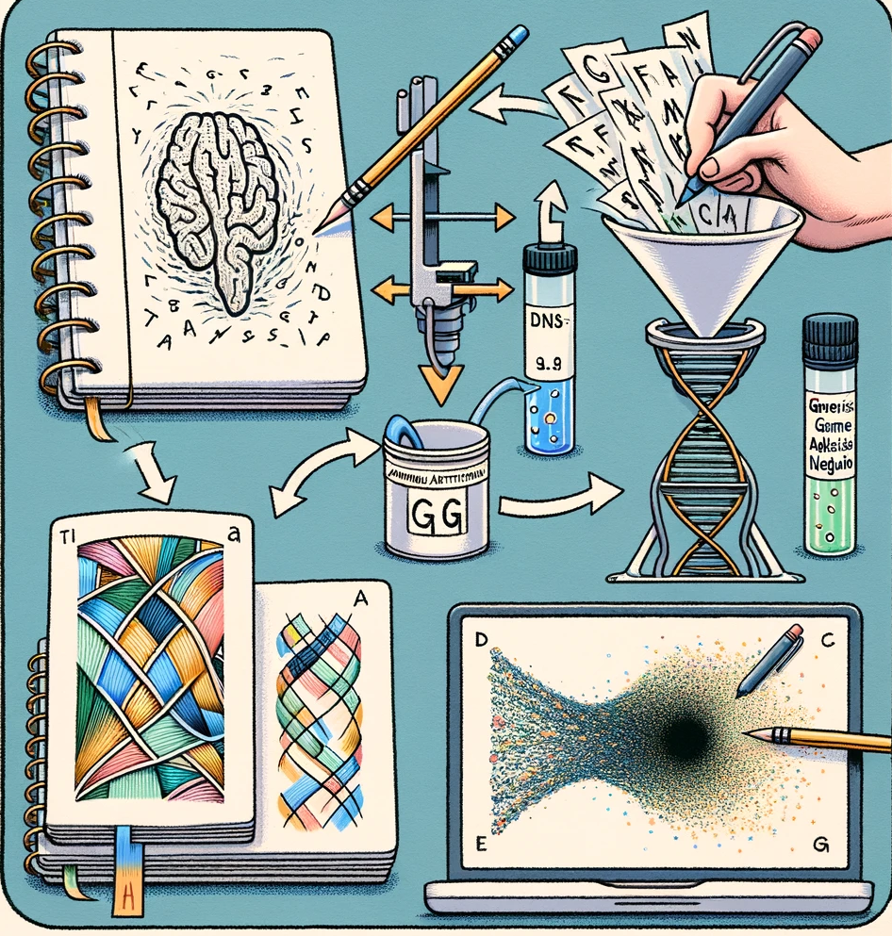
Proposed CGR-DL Approach
State of the Art
Success in classifying DNA sequences with CGR and machine learning encourages applying this method to text analysis.
This paper introduces a novel approach by converting text into images using chaos game representation (CGR) and then analyzing these images with DL models for authorship attribution.

Slide 8
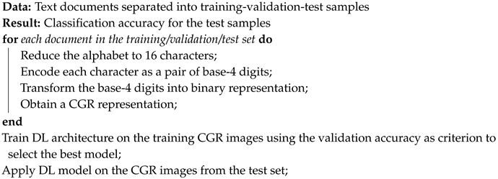
Proposed CGR-DL Approach
The CGR-DL Algorithm

Slide 9
Proposed CGR-DL Approach
From Text to CGR Images
To use CGR, we need to change the regular text alphabet into a base-4 system.
The idea is to represent the text in a way that CGR can work with.
Class | Base-4 | Class | Base-4
{g, h, j} | 00 | {e} | 20
{i, y} | 01 | {n} | 21
{t} | 02 | {\t, \n, (, ), -, +, [, ], 0, 1, ..., 9, ?, !, :, ;, ,, .} | 22
{m} | 03 | {u} | 23
{l, r} | 10 | {b, d, p} | 30
{a} | 11 | {f, v, w} | 31
{␣} | 12 | {c, k, q, x, z} | 32
{s} | 13 | {o} | 33

Slide 10
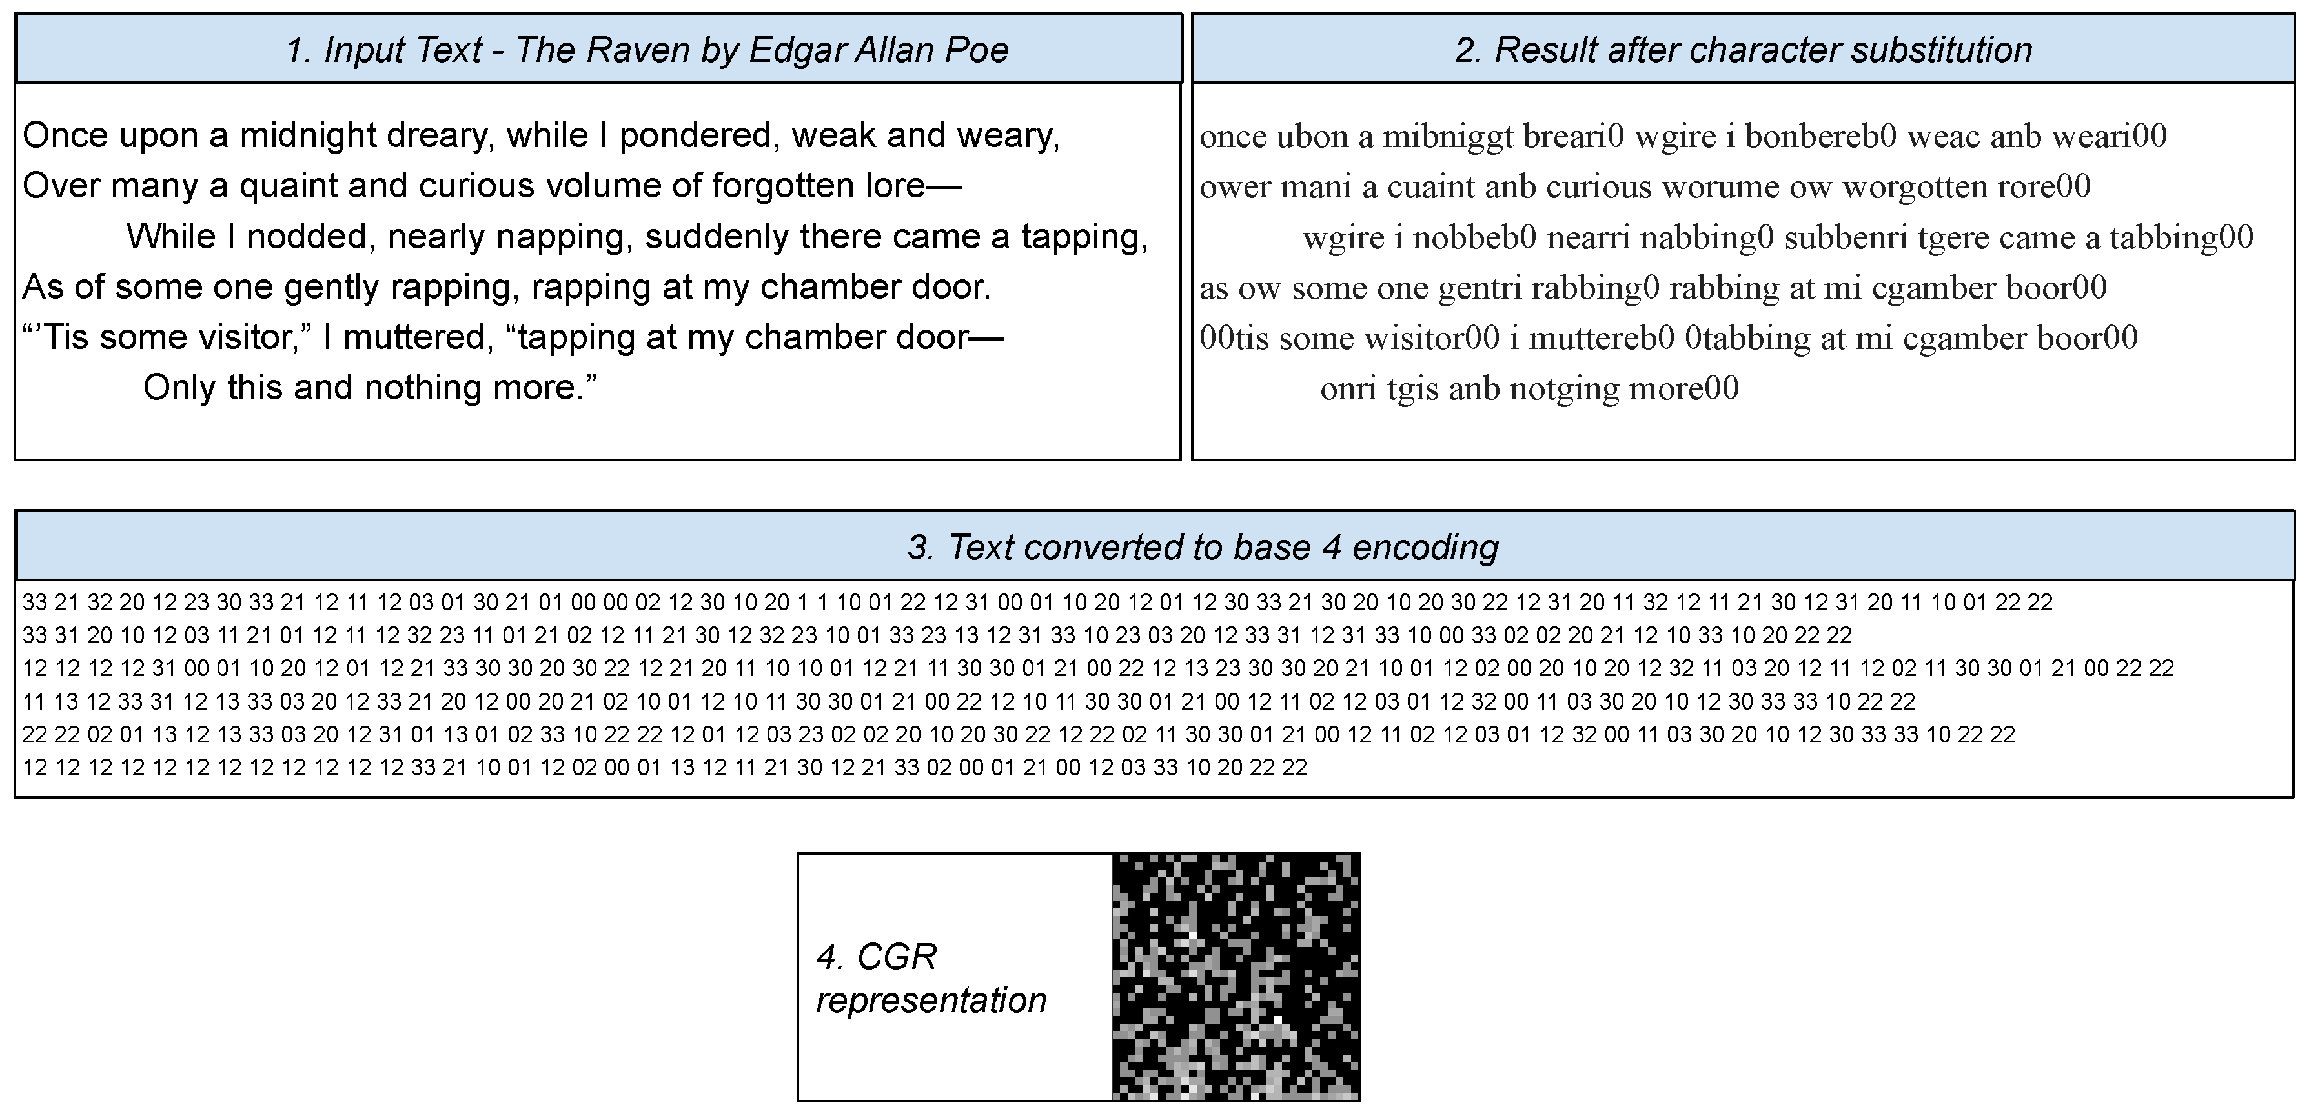
From Text to CGR Images

Slide 11
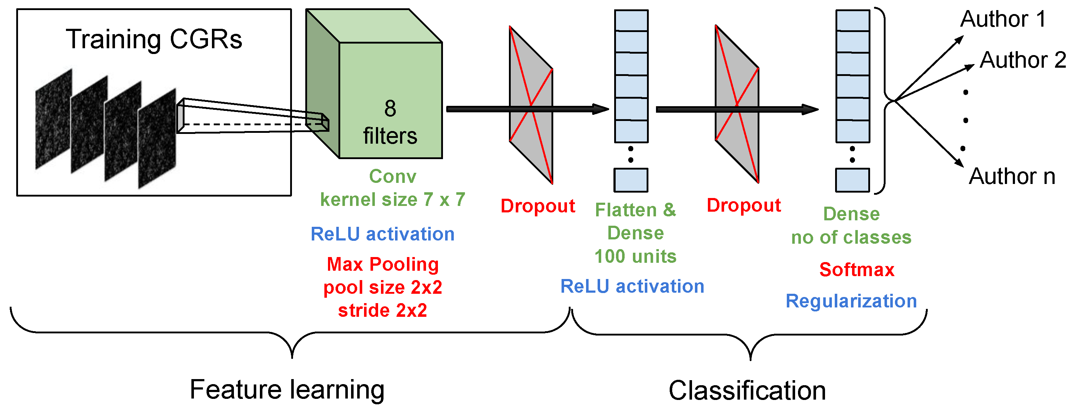
Proposed CGR-DL Approach
Deep Learning Architecture for CGR Images

Slide 12
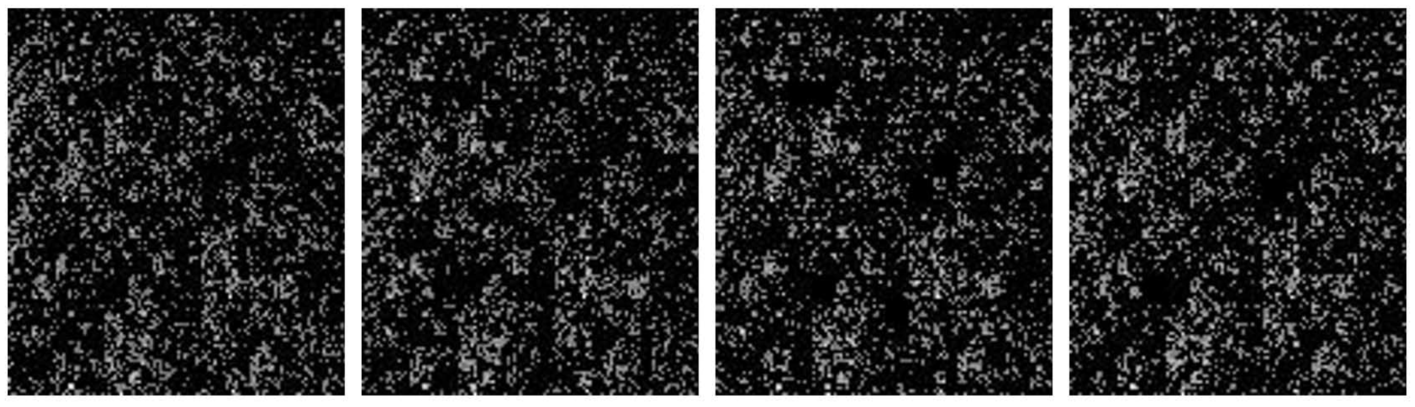

Slide 13
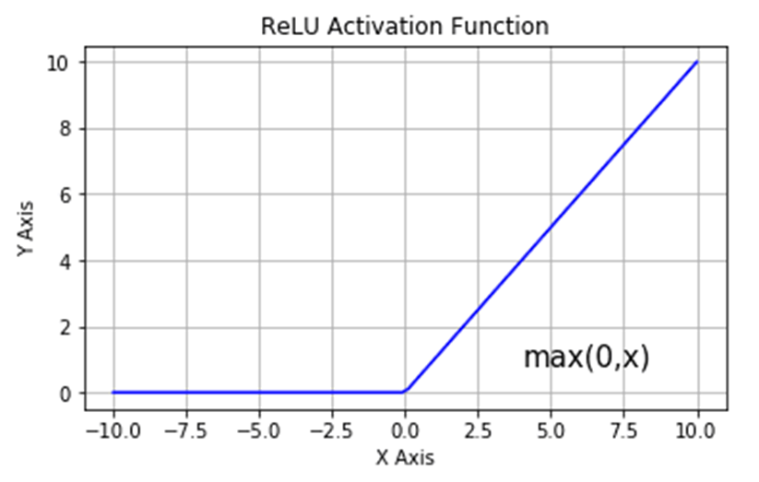
Conv2D | To extract features from the CGR images. It uses filters to create a feature map that highlights important patterns in the image. | This layer scans the image with 8 filters, each of size 7x7 pixels, and applies the ReLU activation function to introduce non-linearity, allowing the model to learn more complex patterns.

Slide 14
MaxPooling2D | To reduce the dimensionality of the feature maps, making the model more efficient and less sensitive to the exact location of features in the input. | This layer takes the maximum value in each 2x2 area of the feature map and pools them into a smaller area, effectively downsizing the input's width and height by half.

Slide 15
Dropout | To prevent overfitting, which is when the model learns the training data too well and doesn't perform well on unseen data. | Randomly sets a fraction (dr1) of input units to 0 during training, which helps the model to generalize better by not relying too much on any one node.

Slide 16
Flatten | To convert the two-dimensional feature maps into a one-dimensional array so that it can be fed into the dense layers for classification. | It flattens the pooled feature maps into a single long vector to be used by the dense layers following it.

Slide 17
Dense (100 units) | To learn high-level features from the flattened input received from the previous layer. | It's a fully connected layer with 100 nodes using the ReLU activation function. It helps to further analyze the data received from the Flatten layer.

Slide 18
Dropout | Again, to reduce overfitting, but after the first dense layer has learned its representations. | Similar to the earlier dropout, but now using a different rate (dr3), it deactivates a fraction of the nodes in the dense layer to encourage more robust learning.

Slide 19
Dense (no of classes) | The final layer that uses the features learned by the network to classify the input into one of the author classes. | It has as many nodes as there are classes (in this case 10) and uses the softmax function to output a probability distribution over the classes.

Slide 20
Regularization | To apply penalties on layer parameters or layer activity during optimization. These penalties are summed into the loss function that the network optimizes. | Both kernel and activity regularizers are applied to the final dense layer to encourage smaller weights (simpler models), which can reduce overfitting and improve generalization.

Slide 21
Experimental Results
Case Study: CCAT10 - Setup
Limited Samples: The CCAT10 data set contains only 50 training and 50 test samples for each of the 10 authors.
Validation Set Creation: 20 training samples per author are used to create a validation set.
Monte Carlo Cross-Validation: A 50% test, 30% training, and 20% validation split is used, with random distribution across 5 separate runs to determine the average performance.

Slide 22
Case Study: CCAT10 - Setup
Scenario | Description | Number of New Images | Techniques Used | Total Images per Author
Data Augmentation | Applied rotation, width/height shifts, and horizontal flips to existing images. | Varies | Rotation, shift ranges, flips | Not specified
Unified Document Splitting | Combined training samples into one, divided into 500, shuffled, and restitched into 50 examples per author, repeated 5 times. | 250 new documents per author, plus original 50 | Shuffling, partitioning, restitching | 300 in training set
GAN Approach | Used GANs to generate 30 new images per class, doubling the training set after 200 epochs. | 30 new images per class, training set doubled | GANs (generator and discriminator) | Training set doubled

Slide 23
Case Study: CCAT10 - Result
Scenario | Description | Test Set Accuracy
Artificially Augmented | First two augmentation methods (Data Augmentation, Unified Document Splitting) | Below 20%
CGR-DL without Augmentation | Original CGR-DL method without any data augmentation | 82%
GAN Approach | Using GANs to generate new images | 83%
When the Monte Carlo cross-validation is used, the average test accuracy reaches 85.52%.

Slide 24
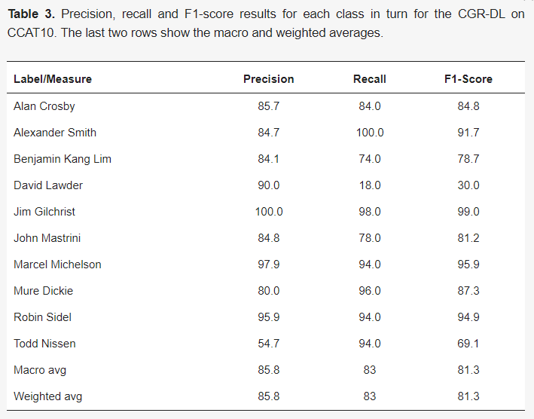
Case Study: CCAT10 - Result

Slide 25
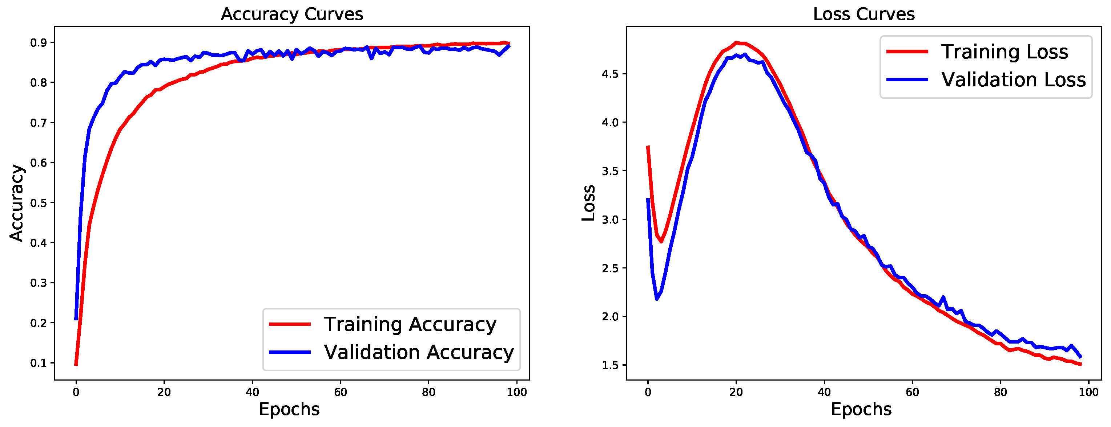
Case Study: IMDb62
IMDb62 provides a large dataset of 62 classes and 79,550 samples for creating CGR images to train a CNN, utilizing 80%-10%-10% for training-validation-test split respectively.
The mean classification accuracy achieved was 90.57% across five repeated training runs of the CNN, with a stable performance noted even when using 5-fold cross-validation.

Slide 26
Conclusion
Questions | Based on Project Findings | Examples/Explanations
Can DL effectively use CGR images to tell authors apart? | Yes, DL can pick up on clues in CGR images to distinguish between authors. | The CNN model achieved an 82% accuracy on the test set without augmentation, indicating it learned to identify authors based on their unique CGR image patterns.
Does DL need many CGR images to be accurate? | More CGR images lead to better and more consistent recognition of authors. | Comparing CCAT10 with IMDb62 showed that the model with access to more images (IMDb62) had validation and test results that were more closely aligned, meaning it learned better and didn't overfit.
Can making more images artificially help improve accuracy when there aren't many samples? | Creating more images artificially did not always improve accuracy. Standard augmentation methods didn't help, but using GANs to generate new images showed better results. | Standard augmentation methods like rotation and flipping resulted in low accuracy (below 20%), but using GANs to double the training data improved the test accuracy to 83%, demonstrating that not all methods of creating new images are equally effective.

Slide 27


